Slide 1
THE REAL LIVING WAGE
& ISLAM
This resource is designed to raise awareness of the
Living Wage and can be used by organisers and leaders to inspire Muslims into ongoing action around the Living Wage campaign.

Slide 2
Poverty and Muslims in UK
Muslims are over-represented in low paid jobs.
Parliamentary Committee, Inquiry: Employment opportunities for Muslims in the UK, 25 January 2016:
“Of all religious groups, Muslims have the lowest employment rate at 47.2%, and the highest pay gap compared with those of no religion, earning 22.5% less.”

Slide 3
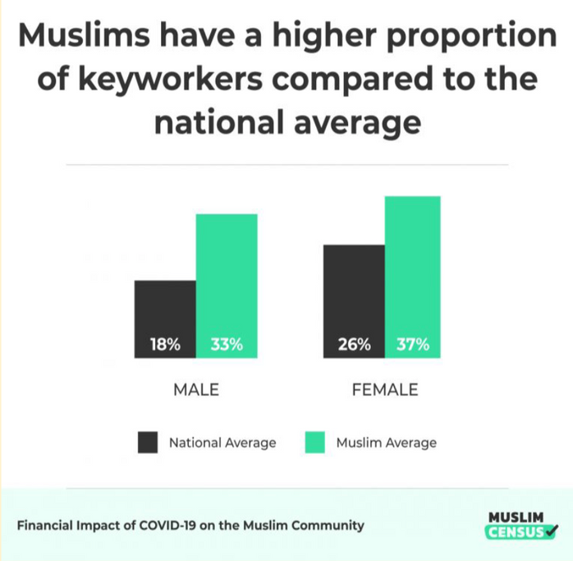
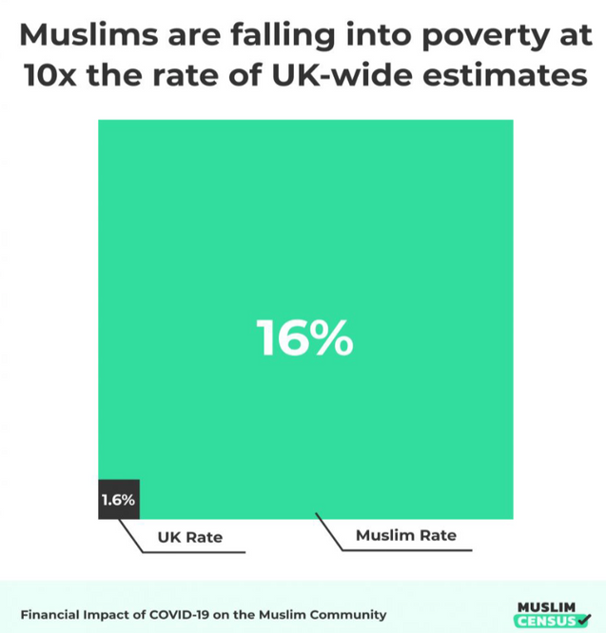
Poverty and Muslims in UK
Muslim Census:
Financial Impact of
COVID-19 on the
Muslim Community,
September 2020
found

Slide 4
Poverty and Muslims in UK
Muslim Census: Financial Impact of COVID-19 on the Muslim Community,
September 2020 found:
7% of Muslims feel they have become eligible to receive Zakat due to the
pandemic
In February 2021, the charity: National Zakat Foundation, said it distributed £3.8
million in grants, a 27% rise from the previous year when £2.9 million was given
out. NZF gives out grants from Zakat, the obligatory religious levy collected from British Muslims for the poor.

Slide 5
Poverty and Muslims in UK: Responses
1. More charity: food banks and hardship grant donations.
2. Campaign for a more generous benefits system: getting rid of the benefit cap, increasing payment rates.
3. More money advice and employment support to claim entitlements and secure better paid jobs.
4. Persuade more employers to pay the real living wage voluntarily, so those in low paid jobs are guaranteed wages based on the cost of living increases.
Demand has been rapidly rising & is seen as a ‘sticking plaster’ response though an important emergency one.
Recent elections have shown this is not a vote winner.
Cuts to legal aid and advice funding has made this very hard.
Cross-party support with almost 10,000 employers signed up.

Slide 6
The significance of work in Islam
•Al-Miqdam (RA) reported: The Messenger of Allah, peace and blessings be
upon him, said:
“No meal eaten by one of you is better than the meal he eats from the work of
his own hands. Verily, the Prophet of Allah, David, upon him be peace, would
eat from the work of his own hands.”
[Source: Ṣaḥīḥ al-Bukhārī 1966]
•It was narrated from 'Aishah (RA) that the Messenger of Allah, peace and
blessings be upon him said:
“The best (most pure) food a man consumes is that which he has earned
himself, and his child (and his child's wealth) is part of his earnings.“
[Source: Sunan Ibn Majah 2137, Book 12, Hadith 1]

Slide 7
Islam & a ‘Living Wage’
Islam talks not only about a minimum but also a just or living wage.
The Prophet Muhammad ﷺ said that:
• “an employee (male/female) is entitled to at least moderately good food
and clothing and not being burdened except what he/she can bear” [Sahih
Muslim and Muwatta Malik]
•“make them (workers) satisfied regarding their basic needs”. [Majma Uz
Zawaid]
•“Those working under you are like your brothers whom God has made your
subordinates. So, he who has his brother working under him let him feed
what he feeds himself and clothe him what he clothes himself with”.
[Sahih al-Bukhari: 2545]
Source: https://islamiclabourcode.org/wages/

Slide 8
What is the real Living Wage?
The real Living Wage is the only UK wage rate that is voluntarily
paid by over 11,000 UK businesses who believe their staff deserve a wage which meets everyday needs - like the weekly shop, or
a surprise trip to the dentist.
Since it’s inception over 20 years ago, the campaign has shifted over £2bn into the pockets of the UK’s lowest paid workers in the UK.
With the cost-of-living crisis deepening, the Living Wage campaign is more important then ever.

Slide 9
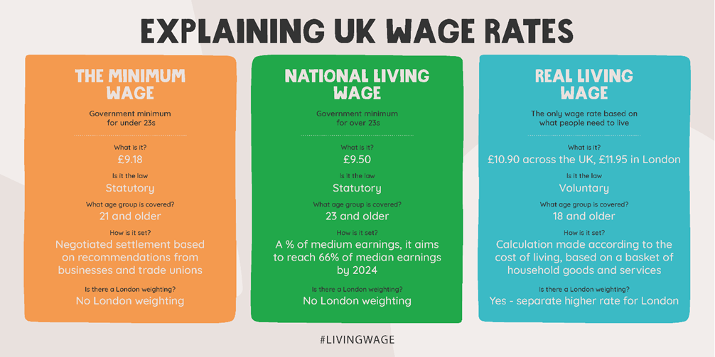
EXPLAINING UK WAGE RATES

Slide 10
Living Wage accredited Muslim employers
Out of 11,000 living wage accredited employers in the
UK, only 3 are Muslim organisations:
1. Muslim Council of Britain
2. Muslim Youth Helpline
3. Cheadle Mosque in Manchester

Slide 11
Question:
Read Abdul Durrant’s story HERE.
If Muslims are overrepresented in low paid jobs, then the real living
wage campaign must be the most significant response to rising in-
work poverty in our community?
Why isn’t it? What could you do about it? Could you work towards your mosque becoming an accredited Living Wage employer? Could you find do some listening with people in your community to better understand how low-pay is affecting them?

